Slide 1
Risk Analysis, Maintenance and Reengineering
Session 31
Course : COMP6100/Software Engineering
Effective Period : Desember 2017

Slide 2
These slides have been adapted from
Pressman, R.S. (2015). Software Engineering : A Practioner's Approach. 8th ed. McGraw-Hill Companies.Inc, Americas, New York. ISBN : 978 1 259 253157. Chapter 35 and 36
Acknowledgement

Slide 3
LO 4 : Analyze the software project management and the proposed potential business project
Learning Objectives

Slide 4
Contents
Reactive versus Proactive Risk Strategies
Software Risk
Software Maintenance
Business Process Reengineering
Software Reengineering
Reverse Engineering
Forward Engineering

Slide 5
Reactive Risk Management
Reactive versus
Proactive Risk Strategies
project team reacts to risks when they occur
mitigation—plan for additional resources in anticipation of fire fighting
fix on failure—resource are found and applied when the risk strikes
crisis management—failure does not respond to applied resources and project is in jeopardy

Slide 6
Proactive Risk Management
Reactive versus
Proactive Risk Strategies
formal risk analysis is performed
organization corrects the root causes of risk
  TQM concepts and statistical SQA
  examining risk sources that lie beyond the bounds of the software
  developing the skill to manage change

Slide 7
Seven Principles
Software Risk
Maintain a global perspective—view software risks within the context of system and the business problem
Take a forward-looking view—think about the risks that may arise in the future; establish contingency plans
Encourage open communication—if someone states a potential risk, don’t discount it.
Integrate—a consideration of risk must be integrated into the software process
Emphasize a continuous process—the team must be vigilant throughout the software process, modifying identified risks as more information is known and adding new ones as better insight is achieved.
Develop a shared product vision—if all stakeholders share the same vision of the software, it likely that better risk identification and assessment will occur.
Encourage teamwork—the talents, skills and knowledge of all stakeholder should be pooled

Slide 8
Risk Management Paradigm
Software Risk
control
track
RISK
identify
plan
analyze

Slide 9
Risk Identification
Software Risk
Product size —risks associated with the overall size of the software to be built or modified.
Business impact —risks associated with constraints imposed by management or the marketplace.
Customer characteristics —risks associated with the sophistication of the customer and the developer's ability to communicate with the customer in a timely manner.
Process definition —risks associated with the degree to which the software process has been defined and is followed by the development organization.
Development environment —risks associated with the availability and quality of the tools to be used to build the product.
Technology to be built —risks associated with the complexity of the system to be built and the "newness" of the technology that is packaged by the system.
Staff size and experience —risks associated with the overall technical and project experience of the software engineers who will do the work.

Slide 10
Assessing Project Risk-I
Software Risk
Have top software and customer managers formally committed to support the project?
Are end-users enthusiastically committed to the project and the system/product to be built?
Are requirements fully understood by the software engineering team and their customers?
Have customers been involved fully in the definition of requirements?
Do end-users have realistic expectations?

Slide 11
Assessing Project Risk-II
Software Risk
Is project scope stable?
Does the software engineering team have the right mix of skills?
Are project requirements stable?
Does the project team have experience with the technology to be implemented?
Is the number of people on the project team adequate to do the job?
Do all customer/user constituencies agree on the importance of the project and on the requirements for the system/product to be built?

Slide 12
Risk Components
Software Risk
performance risk—the degree of uncertainty that the product will meet its requirements and be fit for its intended use.
cost risk—the degree of uncertainty that the project budget will be maintained.
support risk—the degree of uncertainty that the resultant software will be easy to correct, adapt, and enhance.
schedule risk—the degree of uncertainty that the project schedule will be maintained and that the product will be delivered on time.

Slide 13
Risk Projection
Software Risk
Risk projection, also called risk estimation, attempts to rate each risk in two ways
  the likelihood or probability that the risk is real
  the consequences of the problems associated with the risk, should it occur.
The are four risk projection steps:
  establish a scale that reflects the perceived likelihood of a risk
  delineate the consequences of the risk
  estimate the impact of the risk on the project and the product,
  note the overall accuracy of the risk projection so that there will be no misunderstandings.

Slide 14
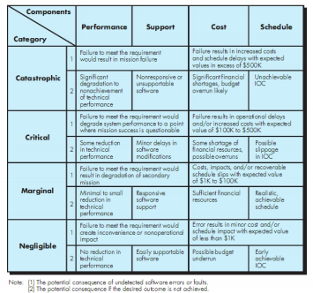
Impact assessment
Software Risk

Slide 15
Building the Risk Table
Software Risk
Estimate the probability of occurrence
Estimate the impact on the project on a scale of 1 to 4, where
  1 = catastrophic
  2 = critical
  3 = marginal
  4 = negligible
sort the table by probability and impact

Slide 16
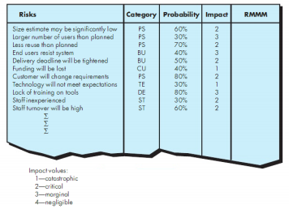
Sample risk table prior to sorting
Software Risk

Slide 17
Risk Exposure (Impact)
Software Risk
The overall risk exposure, RE, is determined using the following relationship [Hal98]:
RE = P x C
where
P is the probability of occurrence for a risk, and
C is the cost to the project should the risk occur.

Slide 18
Risk Exposure Example
Software Risk
Risk identification. Only 70 percent of the software components scheduled for reuse will, in fact, be integrated into the application. The remaining functionality will have to be custom developed.
Risk probability. 80% (likely).
Risk impact. 60 reusable software components were planned. If only 70 percent can be used, 18 components would have to be developed from scratch (in addition to other custom software that has been scheduled for development). Since the average component is 100 LOC and local data indicate that the software engineering cost for each LOC is $14.00, the overall cost (impact) to develop the components would be 18 x 100 x 14 = $25,200.
Risk exposure. RE = 0.80 x 25,200 ~ $20,200.

Slide 19
Risk Mitigation, Monitoring, and Management
Software Risk
Mitigation —how can we avoid the risk?
Monitoring —what factors can we track that will enable us to determine if the risk is becoming more or less likely?
Management —what contingency plans do we have if the risk becomes a reality?

Slide 20
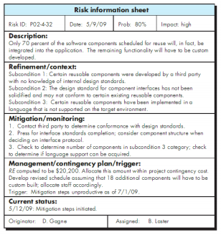
Risk information sheet
Software Risk

Slide 21
Software Maintenance
Software is released to end-users, and
  within days, bug reports filter back to the software engineering organization.
  within weeks, one class of users indicates that the software must be changed so that it can accommodate the special needs of their environment.
  within months, another corporate group who wanted nothing to do with the software when it was released, now recognizes that it may provide them with unexpected benefit. They’ll need a few enhancements to make it work in their world.
All of this work is software maintenance

Slide 22
Maintainable Software
Software Maintenance
Maintainable software exhibits effective modularity
It makes use of design patterns that allow ease of understanding.
It has been constructed using well-defined coding standards and conventions, leading to source code that is self-documenting and understandable.
It has undergone a variety of quality assurance techniques that have uncovered potential maintenance problems before the software is released.
It has been created by software engineers who recognize that they may not be around when changes must be made.
  Therefore, the design and implementation of the software must “assist” the person who is making the change

Slide 23
Software Supportability
Software Maintenance
“the capability of supporting a software system over its whole product life.
  This implies satisfying any necessary needs or requirements, but also the provision of equipment, support infrastructure, additional software, facilities, manpower, or any other resource required to maintain the software operational and capable of satisfying its function.” [SSO08]
The software should contain facilities to assist support personnel when a defect is encountered in the operational environment (and make no mistake, defects will be encountered).
Support personnel should have access to a database that contains records of all defects that have already been encountered—their characteristics, cause, and cure.

Slide 24
Reengineering
Business Process
Reengineering
Business
processes
IT
systems
Software
applications
Reengineering

Slide 25
Business Process
Reengineering
Business definition. Business goals are identified within the context of four key drivers: cost reduction, time reduction, quality improvement, and personnel development and empowerment.
Process identification. Processes that are critical to achieving the goals defined in the business definition are identified.
Process evaluation. The existing process is thoroughly analyzed and measured.
Process specification and design. Based on information obtained during the first three BPR activities, use-cases are prepared for each process that is to be redesigned.
Prototyping. A redesigned business process must be prototyped before it is fully integrated into the business.
Refinement and instantiation. Based on feedback from the prototype, the business process is refined and then instantiated within a business system.

Slide 26
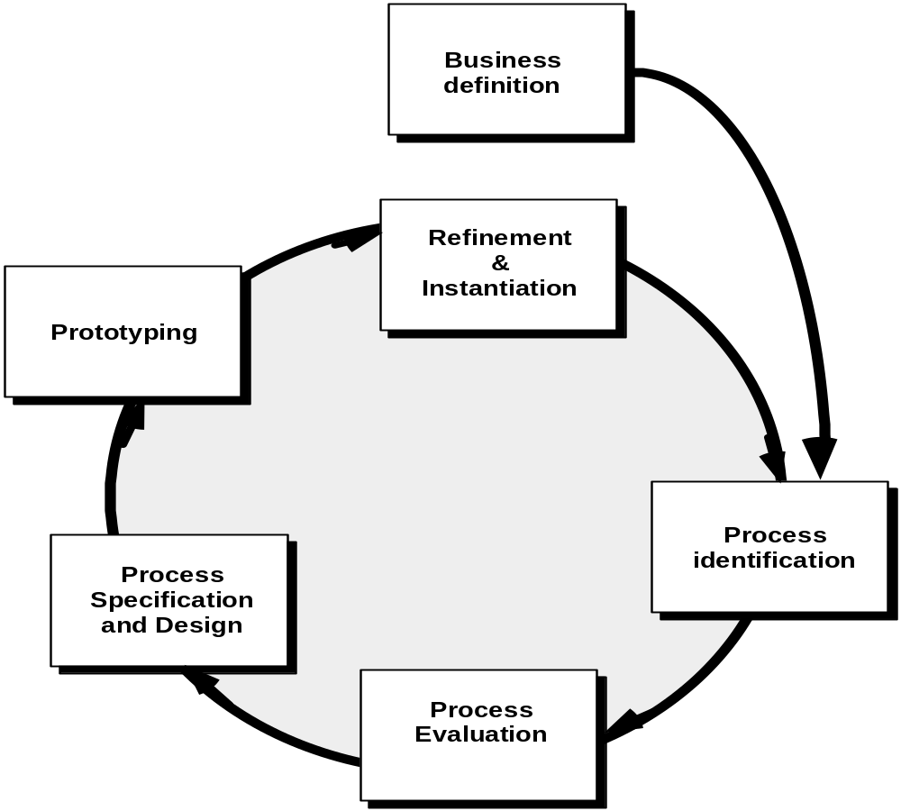
Business Process
Reengineering

Slide 27
BPR Principles
Business Process
Reengineering
Organize around outcomes, not tasks.
Have those who use the output of the process perform the process.
Incorporate information processing work into the real work that produces the raw information.
Treat geographically dispersed resources as though they were centralized.
Link parallel activities instead of integrated their results. When different
Put the decision point where the work is performed, and build control into the process.
Capture data once, at its source.

Slide 28
Software Reengineering
Forward
engineering
inventory
analysis
Data
restructuring
document
restructuring
code
restructuring
reverse
engineering

Slide 29
Inventory Analysis
Software Reengineering
build a table that contains all applications
establish a list of criteria, e.g.,
  name of the application
  year it was originally created
  number of substantive changes made to it
  total effort applied to make these changes
  date of last substantive change
  effort applied to make the last change
  system(s) in which it resides
  applications to which it interfaces, ...
analyze and prioritize to select candidates for reengineering

Slide 30
Document Restructuring
Software Reengineering
Weak documentation is the trademark of many legacy systems.
But what do we do about it? What are our options?
Options …
  Creating documentation is far too time consuming. If the system works, we’ll live with what we have. In some cases, this is the correct approach.
  Documentation must be updated, but we have limited resources. We’ll use a “document when touched” approach. It may not be necessary to fully redocument an application.
  The system is business critical and must be fully redocumented. Even in this case, an intelligent approach is to pare documentation to an essential minimum.

Slide 31
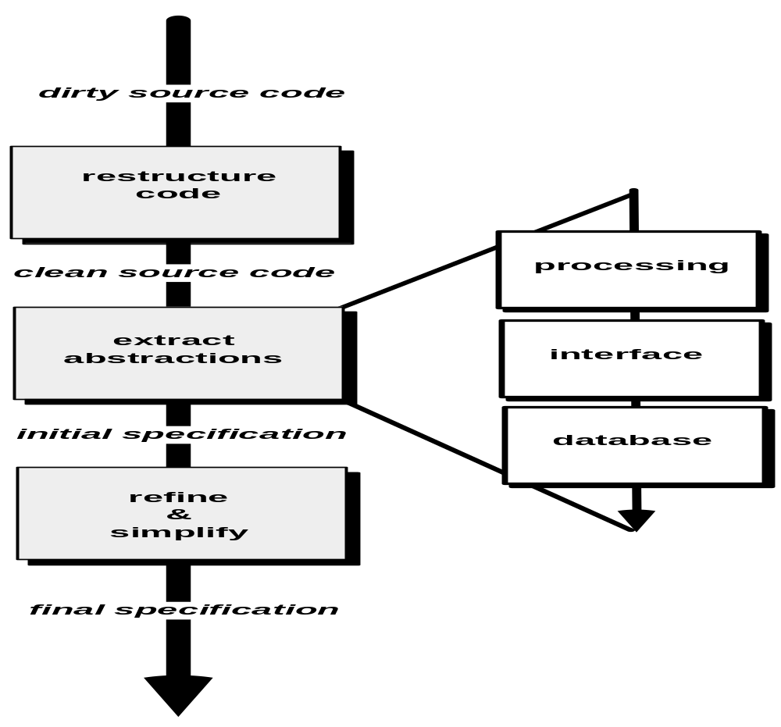
Reverse Engineering

Slide 32
Code Restructuring
Reverse Engineering
Source code is analyzed using a restructuring tool.
Poorly design code segments are redesigned
Violations of structured programming constructs are noted and code is then restructured (this can be done automatically)
The resultant restructured code is reviewed and tested to ensure that no anomalies have been introduced
Internal code documentation is updated.

Slide 33
Data Restructuring
Reverse Engineering
Unlike code restructuring, which occurs at a relatively low level of abstraction, data structuring is a full-scale reengineering activity
In most cases, data restructuring begins with a reverse engineering activity.
  Current data architecture is dissected and necessary data models are defined.
  Data objects and attributes are identified, and existing data structures are reviewed for quality.
  When data structure is weak (e.g., flat files are currently implemented, when a relational approach would greatly simplify processing), the data are reengineered.
Because data architecture has a strong influence on program architecture and the algorithms that populate it, changes to the data will invariably result in either architectural or code-level changes.

Slide 34
Forward Engineering
1. The cost to maintain one line of source code may be 20 to 40 times the cost of initial development of that line.
2. Redesign of the software architecture (program and/or data structure), using modern design concepts, can greatly facilitate future maintenance.
3. Because a prototype of the software already exists, development productivity should be much higher than average.
4. The user now has experience with the software. Therefore, new requirements and the direction of change can be ascertained with greater ease.
5. CASE tools for reengineering will automate some parts of the job.
6. A complete software configuration (documents, programs and data) will exist upon completion of preventive maintenance.

Slide 35
Economics of Reengineering-I
Forward Engineering
A cost/benefit analysis model for reengineering has been proposed by Sneed [Sne95]. Nine parameters are defined:
    P₁ = current annual maintenance cost for an application.
    P₂ = current annual operation cost for an application.
    P₃ = current annual business value of an application.
    P₄ = predicted annual maintenance cost after reengineering.
    P₅ = predicted annual operations cost after reengineering.
    P₆ = predicted annual business value after reengineering.
    P₇ = estimated reengineering costs.
    P₈ = estimated reengineering calendar time.
    P₉ = reengineering risk factor (P₉ = 1.0 is nominal).
    L = expected life of the system.

Slide 36
Economics of Reengineering-II
Forward Engineering
The cost associated with continuing maintenance of a candidate application (i.e., reengineering is not performed) can be defined as
C_{maint} = [P₃ - (P₁ + P₂)] x L
The costs associated with reengineering are defined using the following relationship:
C_{reeng} = [P₆ - (P₄ + P₅) x (L - P₈) - (P₇ x P₉)] `
Using the costs presented in equations above, the overall benefit of reengineering can be computed as
cost benefit = C_{reeng} - C_{maint}

Slide 37
References
Pressman, R.S. (2015). Software Engineering : A Practioner's Approach. 8th ed. McGraw-Hill Companies.Inc, Americas, New York. ISBN : 978 1 259 253157.
Risk Management & operational Risk
http://www.grafp.com/products/risk-manage.html
Sw maintenance and Reengineering
http://www.csse.monash.edu.au/~jonmc/CSE2305/Topics/13.25.SWEng4/html/text.html

Slide 38
Q & A

